Slide 1





Accelerate .NET to Azure with GitHub Actions
Again?
Isaac Levin
Principal Product Marketing Manager
@isaacrlevin

Slide 2

What we learned last time
You can create GitHub Actions from Visual Studio
There are many options to deploy .NET to Azure
GitHub Actions are a great way to configure your CICD

Slide 3
Ok… So you are doing the same talk?
Nah that’s lame
Think of this as the next class in a .NET + GitHub Actions + Azure course
Showcase of tools that will make the experience better

Slide 4
Using GitHub Environments is a good idea
Approvals
Waiting
Branches
Secrets at Environment level

Slide 5
Tools to Extend GitHub Actions
ACT
VS Code Extensions
action-tmate
Call out some ones you use I didn’t mention!

Slide 6

GitHub Actions being Extra
Demo

Slide 7
What about tests?
Playwright to the rescue
UI Testing and Automation Library
Open Source
Works with Chromium-based browsers, Firefox and WebKit
Installs as dotnet global tool once, than added to code via Nuget
Can run in headless mode as well (I wonder where we can use that)
Can use for post-deployment checks inside GitHub Actions
Running tests on a site after publish? YES PLEASE!

Slide 8

your tests with GitHub Actions
Demo

Slide 9
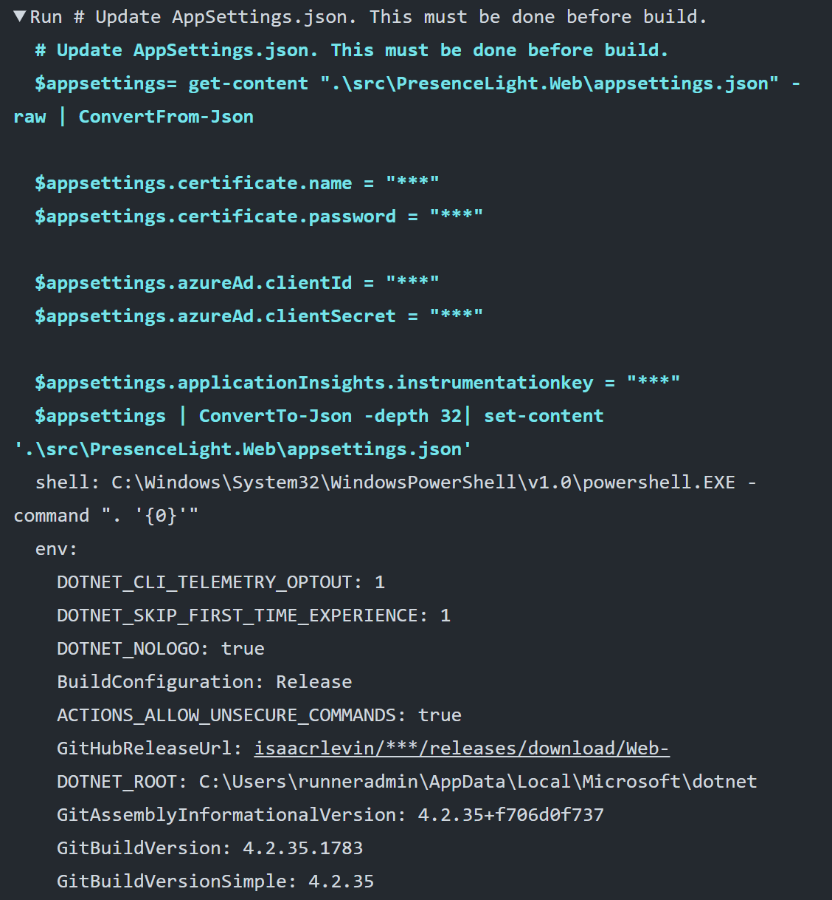

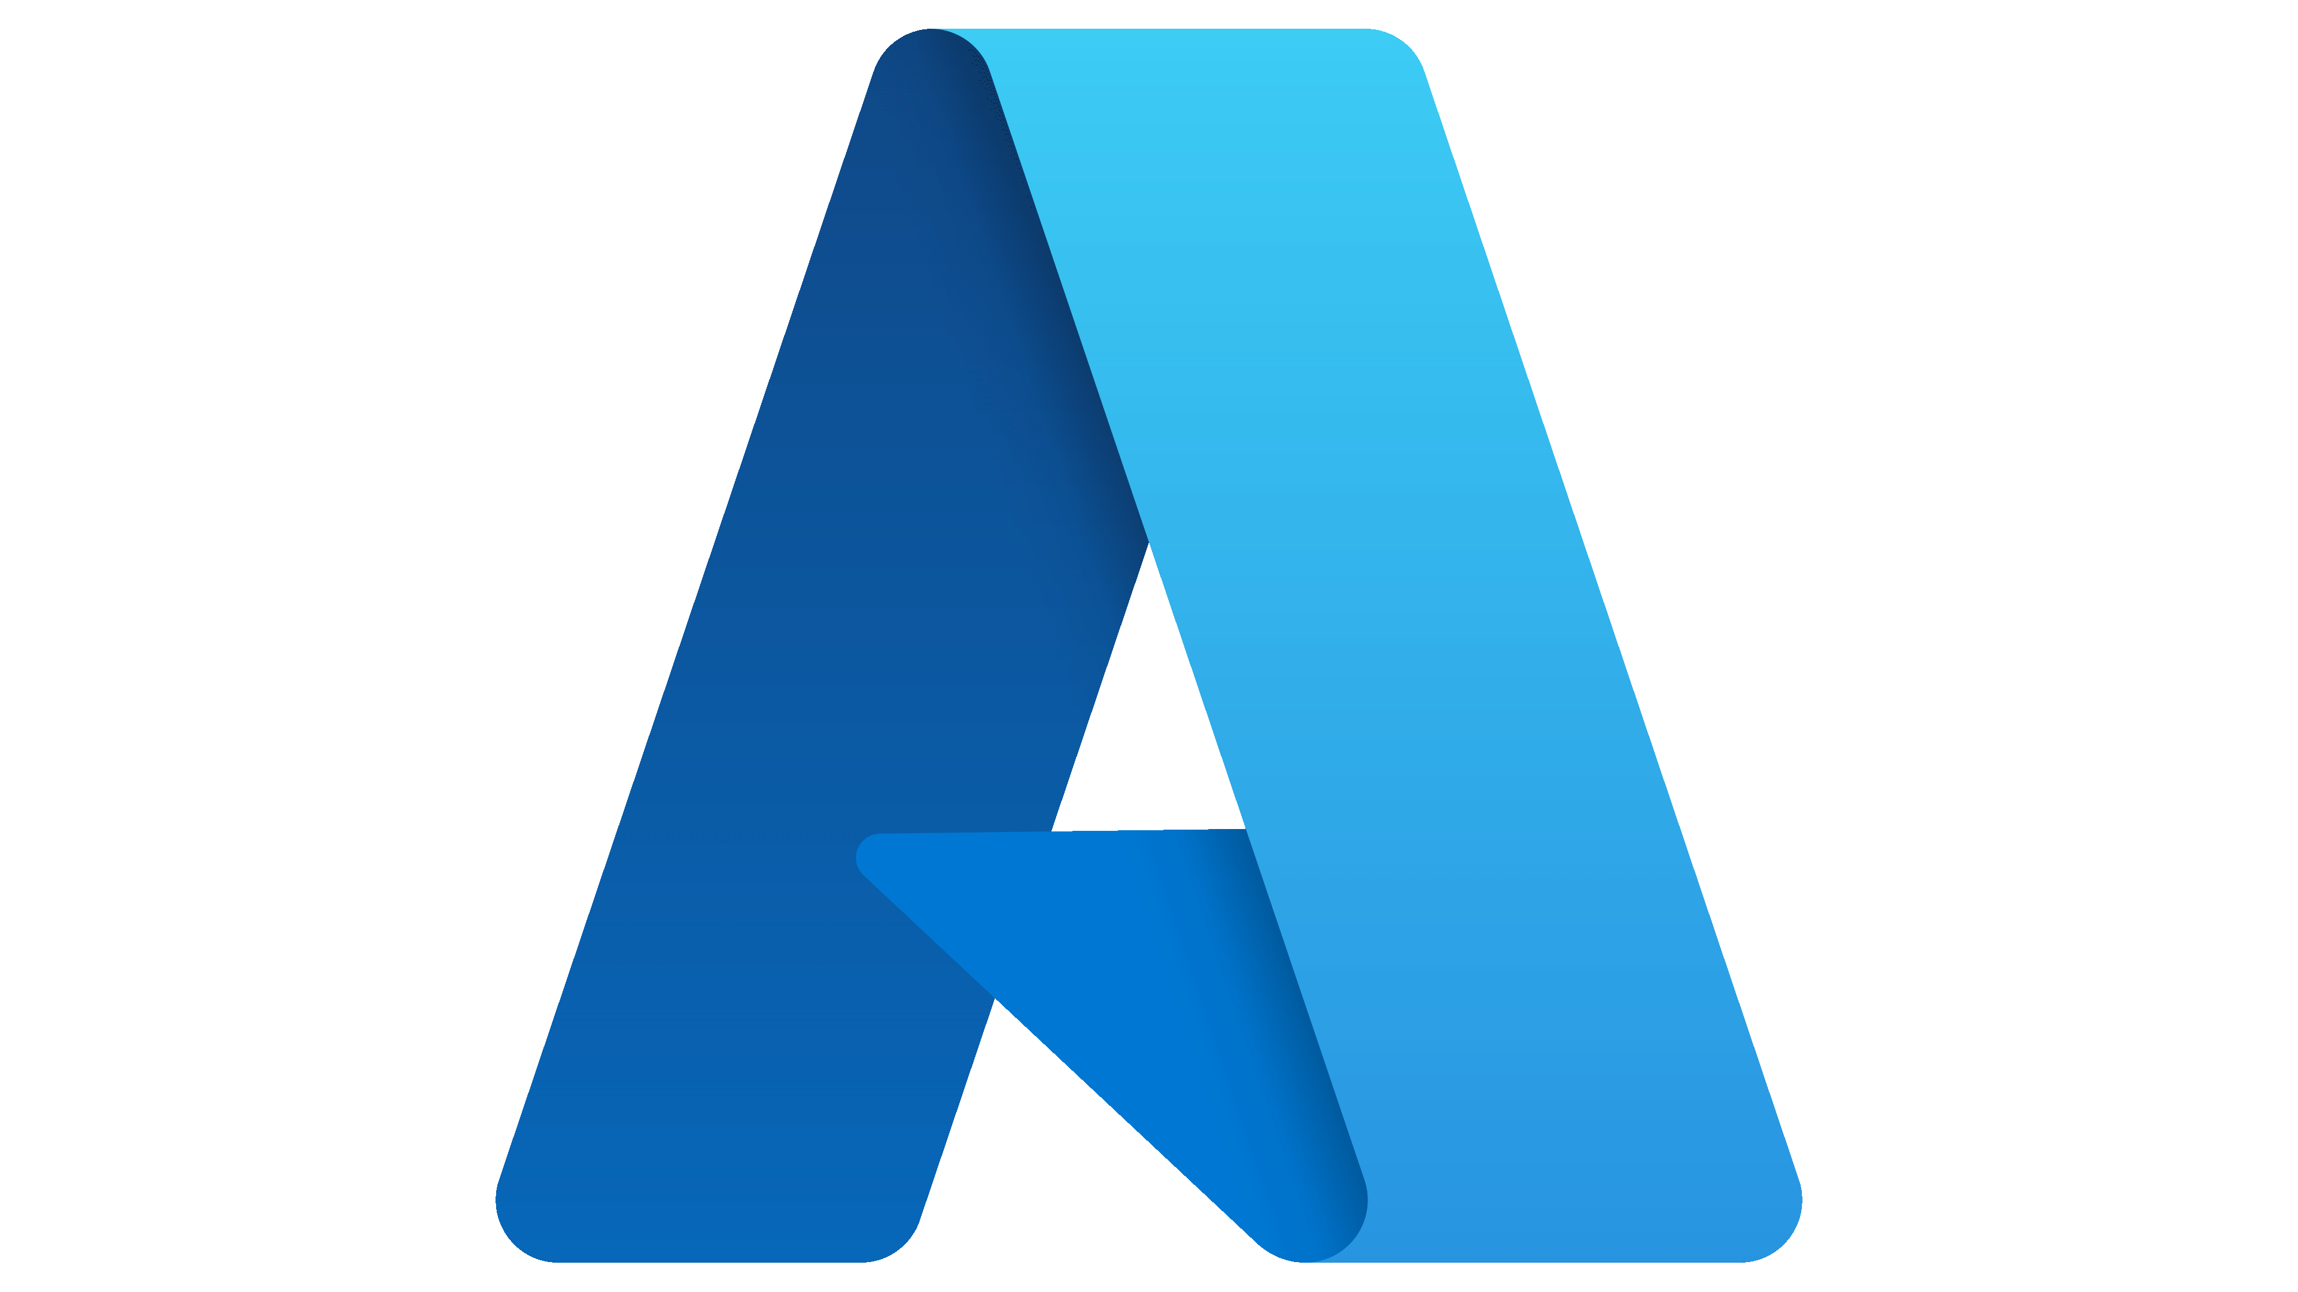



Using CLIs in a GitHub Action
Runners have tons of pre-installed tools

Slide 10
A new way to review PRs
Demo

Slide 11

Thanks for joining!
https://isaacl.dev/actions-dotnet-azure

